Slide 1
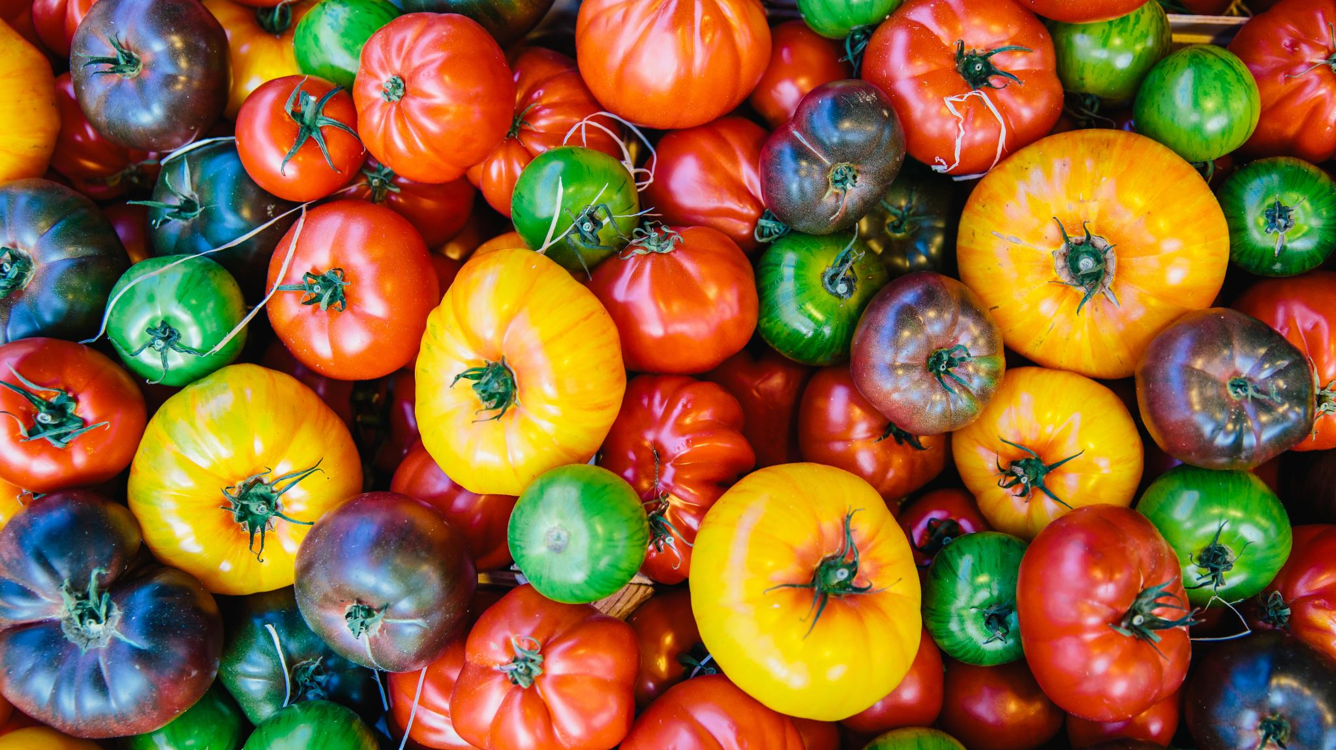
Domestication impact on tomato flavor
Group 5
Lindsay Shields, Sangeetha Vijayam, and Emmanuel Baah

Slide 2
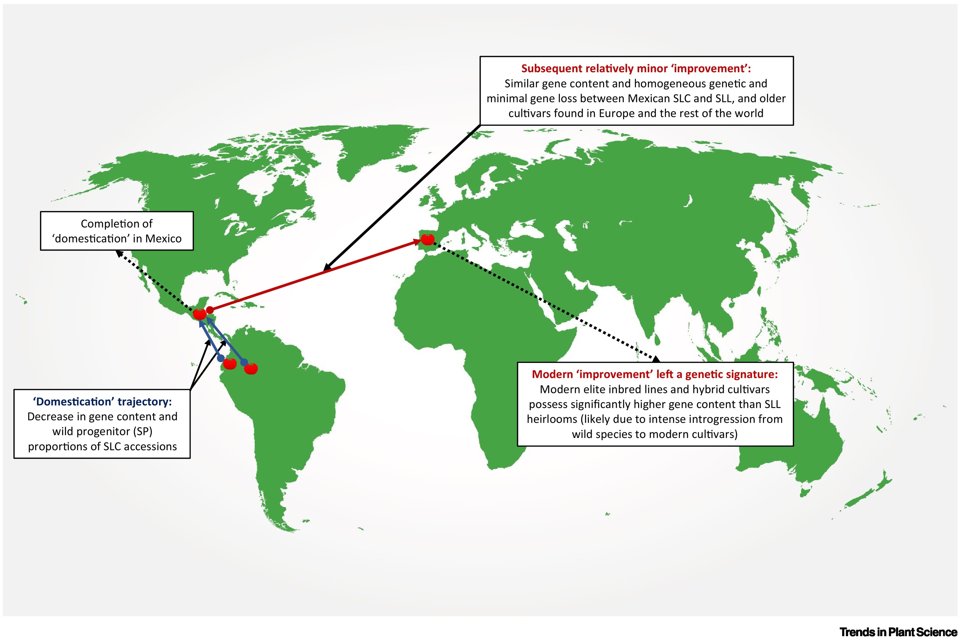
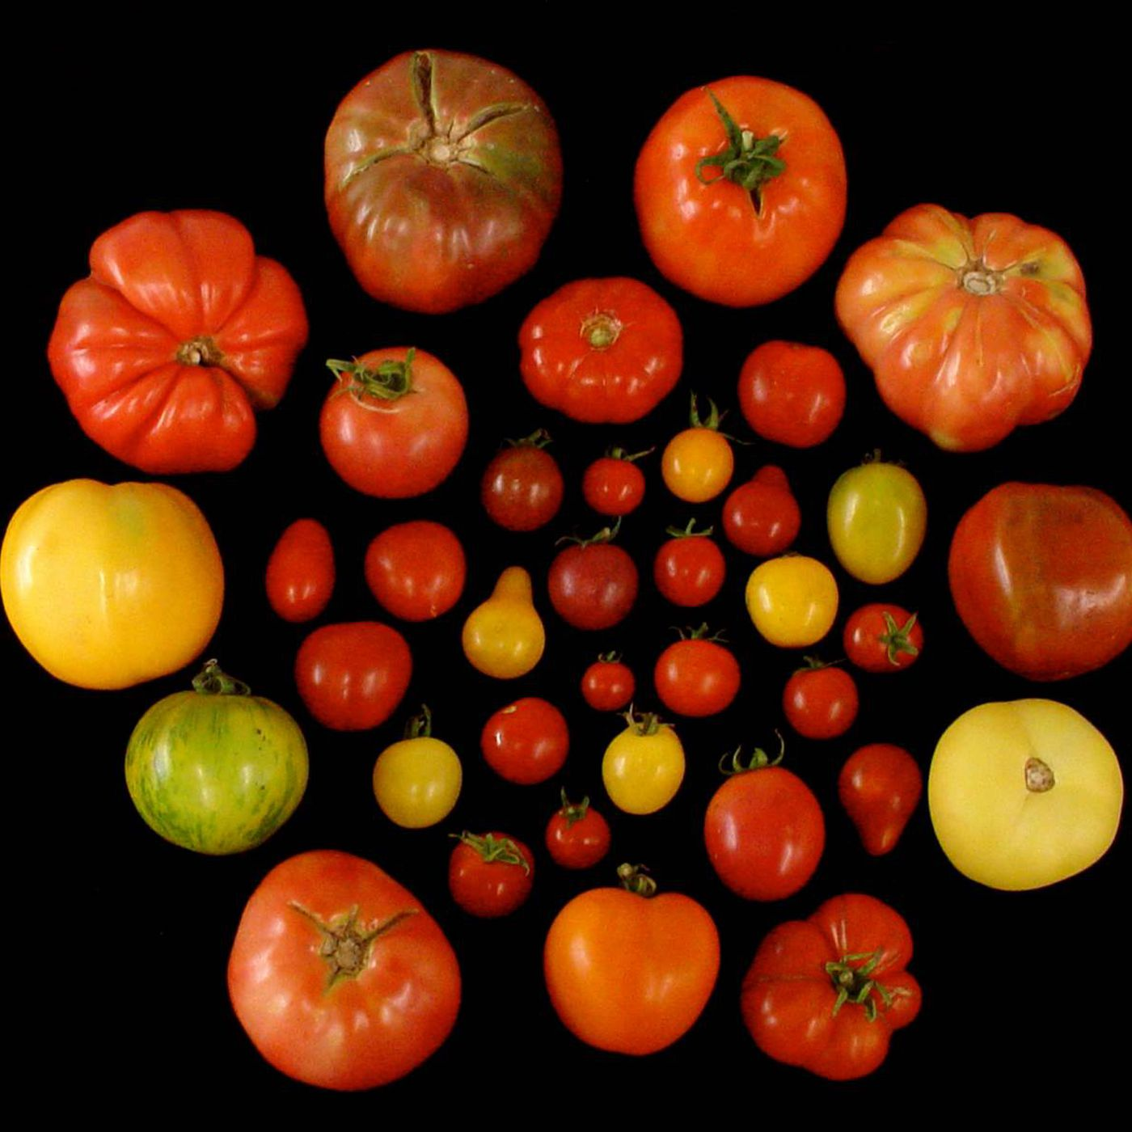
Domestication
Tomato is a globally significant community crop
Originated in South America
Migrated north to Mexico
Dispersed to Old World via Columbian exchange
Highly diverse

Slide 3
Domestication
Wild varieties
Undomesticated , relatives of the modern tomato (Solanum pimpinellifolium)
Heirloom varieties
Domesticated, but have not undergone intensive selection for industrial traits
Modern varieties
domesticated, undergone strong selection for crop improvement
Notes:
Wild varieties
Really small, about the size of a blueberry
Heirloom varieties
Come in all shapes, sizes, colors
Industrial traits* uniformity, color, shape -- any selection they have been under has been specific to the region in which they grow in
Also typically grown under organic agricultural practices
Modern varieties
Crop improvement – broad term to describe the breeding pipeline for traits appealing to consumers and farmers, uniformity, color, shape, fruit size pest/pathogen resistance etc.

Slide 4
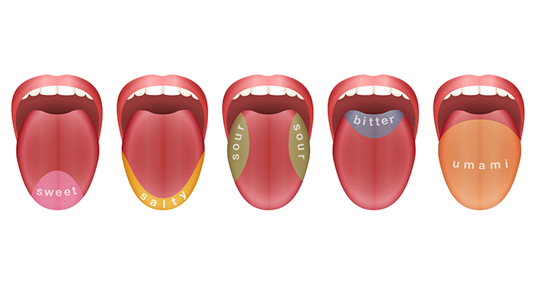
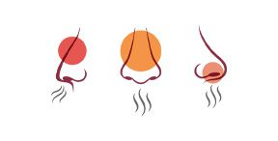
Impact on Flavor
Consumers believe that flavor has deteriorated in modern varieties compared to heirloom
Wild being the most flavorful
Flavor is complex trait and difficult to quantify as one entity
Flavor is determined by the interaction between taste and olfaction
Taste ← response from sugars and acids
Olfaction ← response from volatile compounds
Notes:
Flavor is not additive!! Increase and decrese of a particular compound does not necessarily make the flavor good

Slide 5
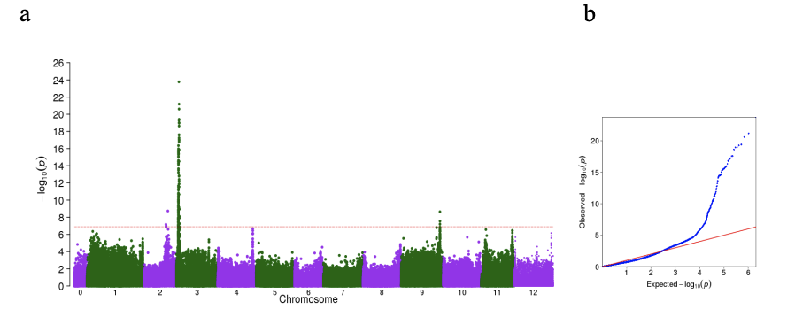
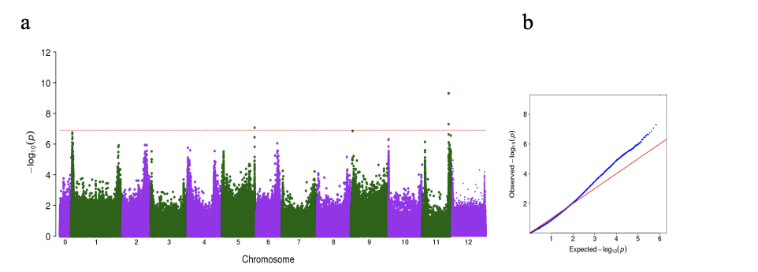
Impact on Flavor
Authors investigated the difference in sugars, acids, and volatile compounds across the different varieties, in hope to elucidate important contributors to flavor
MHO
Glucose
They identified sugar content and MHO concentration to be significantly associated with flavor
Notes:
Disucss the relationship between MHO and fruit color
Discuss the relationship sugar content and fruit size

Slide 6
Data
Diversity Panel
398 varieties
Metabolite data
Consumer Panel
90 varieties
Scored data
51 modern
volatile, acids, sugars
9 modern
3 wild
41 heirloom
Consumer preference
Sensory attributes (textures, sweetness, etc..)
54 wild
243 heirloom
Data was log3 transformed
* Not all varieties used the study was assigned a ‘type’

Slide 7
Objectives
ANOVA
Given that consumers say there is flavor difference between wild, heirloom and modern varieties,
Two Sample Z Test
Given that MHO is found to be associated with flavor and directly related with fruit color,
Linear Regression
Given that sweetness is considered a ‘good’ contributor to fruit flavor,
We expect that consumer preference will be statically different across groups.
We expect that modern varieties will have higher [MHO] compared to wild varieties.
We expect that sugar content will increase with consumer preference

Slide 8
ANOVA
Hypothesis: We expect that consumer preference will be statically different across groups
H0: μ1 = μ2 = μ3
Ha: All μ are not the same
n_{modern}=9 n_{wild} =3 n_{heirloom}=41
Test for Variance:
Bartlett test of homogeneity of variances
P-value=0.075
Because the p-value of the Bartlett test is greater than 0.05, The variances are not significantly different from each other
Perform a Kruskal-Wallis instead

Slide 9
ANOVA
Kruskal-Wallis Test Statistic :
> kruskal.test(d_list)
Kruskal-Wallis chi-squared = 5.9604, df = 2, p-value = 0.0507
Critical Value:
>qchisq(0.95,2) =5.991465
Conclusion:
The chi-squared test statistic is about the same as the critical value, and the p-value is equal to 0.05. The null hypothesis could be rejected, concluding that the mean rank of the 3 groups are statistically different
Notes:
(I’ll highlight the significance of a close call)

Slide 10
Two Sample Z test
Hypothesis: We expect that modern varieties will have higher [MHO] compared to wild varieties.
H0: μWild - μModern ≥ 0
Ha: μWild - μModern < 0
n_{wild}=54; n_{modern}=51
Test for Normality:
>shapiro.test(df$log3_MHO[which(df$group== “wild”)]) > shapiro.test(df$log3_MHO[which(df$group== “modern”)])
P-value=0.2898 P-value=0.001836
P –value < 0.05, MHO data for the modern group was found to significantly deviate from normal distribution
We are still using an independent two-sample Z test because n > 30 and we are evaluating means

Slide 11
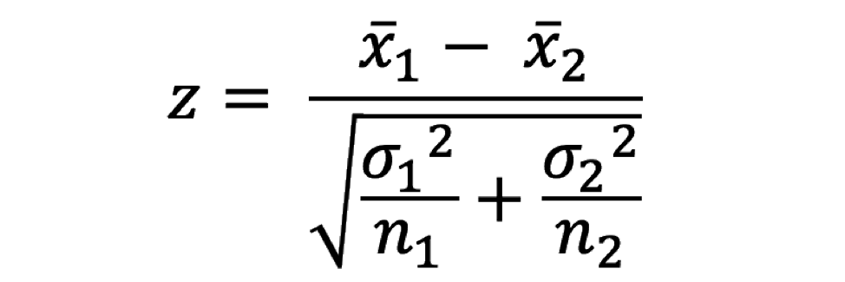
Two Sample Z test
Z statistic:
>xbar.wild <- mean(df$log3_MHO[which(df$group=="wild")])
>xbar.modern<-mean(df$log3_MHO[which(df$group=="modern")])
>sd.wild<-sd(df$log3_MHO[which(df$group=="wild")])
>sd.modern<-sd(df$log3_MHO[which(df$group=="modern")])
>Z <-(xbar.wild-xbar.modern)/(sqrt(((sd.wild^2)/n_{wild})+((sd.modern^2)/n_{modern})))

Slide 12
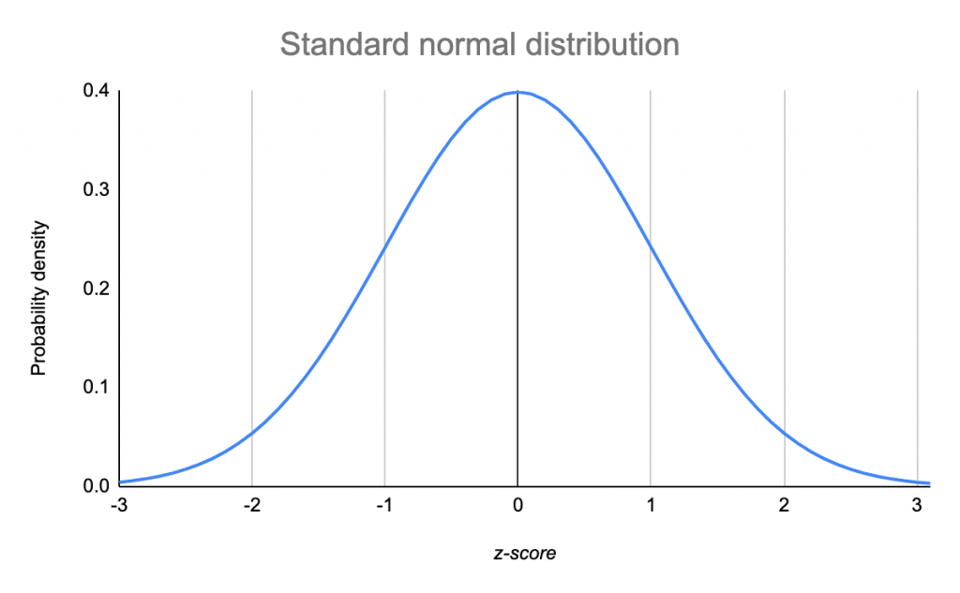
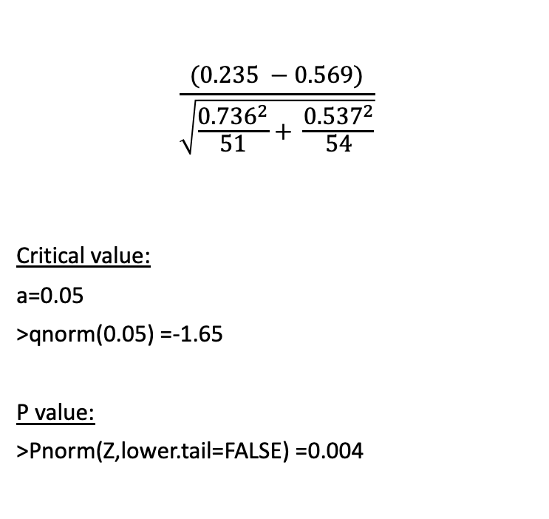
Two Sample Z test
$$\frac{(0.235 −0.569)}{\sqrt{\frac{{0.736}^{2}}{51}+ \frac{{0.537}^{2}}{54}}}$$
Critical value:
a=0.05
>qnorm(0.05) =-1.65
P value:
>Pnorm(Z,lower.tail=FALSE) =0.004
Z statistic:
xbar.wild =0.2350259
xbar.modern=0.5689275
sd.wild=0.7359467
sd.modern=0.536862
z =
z = -2.67
Z=-2.67
Z_{crit}= -1.65
Conclusion: Since my test statistic is less than my critical value and because my p-value is less than 0.05, we have significant evidence to reject the null hypothesis. [MHO] increases in modern varieties compared to wild.

Slide 13
Linear Regression
Predictors: metabolite 1: glucose and metabolite 2: citric acid and sensory attribute 3: sweetness
y: Overall liking
Perform separate simple linear regressions, one for each predictor
Find the largest contributor using the lm() function and stepwise model
Create Dataframe from excel data:
> tomatoDF <- data.frame(y, sweetness, citric, glucose)
Test for normality:
> shapiro.test(y) > shapiro.test(glucose) > shapiro.test(citric) > shapiro.test(sweetness)
p-value = 0.06683 p-value = 0.1793 p-value = 0.4216 p-value = 0.1745
p-value > 0.05 so data is normally distributed

Slide 14
Linear Regression
Generate Linear Model:
sweetnessModel<-lm(y~sweetness, tomatoDF)
glucoseModel<-lm(y~glucose, tomatoDF)
citricModel<-lm(y~citric, tomatoDF)
threeModels<-lm(y~glucose+citric+sweetness, tomatoDF)
> summary(threeModels)

Slide 15
Linear Regression
Call:
lm(formula = y ~ glucose + citric + sweetness, data = tomatoDF)
Residuals:
Min 1Q Median 3Q Max
-8.3203 -2.0033 -0.1523 2.3727 7.4428
Coefficients:
Estimate Std. Error t value Pr(>|t|)
(Intercept) -1.6123 2.1606 -0.746 0.458
glucose 0.1804 0.1343 1.343 0.183
citric 0.2521 0.5331 0.473 0.638
sweetness 0.8257 0.1458 5.662 1.99e-07 ***
---
Signif. codes: 0 ‘***’ 0.001 ‘**’ 0.01 ‘*’ 0.05 ‘.’ 0.1 ‘ ’ 1
Residual standard error: 3.669 on 85 degrees of freedom
Multiple R-squared: 0.5534, Adjusted R-squared: 0.5376
F-statistic: 35.11 on 3 and 85 DF, p-value: 7.369e-15
Conclusion: Based on p value sweetness is the largest contributor to the overall linear model

Slide 16
Stepwise Model
> stepmodel<-step(lm(y~., tomatoDF))
Start: AIC=235.31 Step: AIC=233.19
y ~ sweetness + citric + glucose y ~ sweetness
Df Sum of Sq RSS AIC Df Sum of Sq RSS AIC
- citric 1 3.01 1147.4 233.54 <none> 1168.9 233.19
- glucose 1 24.30 1168.7 235.18 - sweetness 1 1393.7 2562.5 301.05
<none> 1144.4 235.31
- sweetness 1 431.59 1576.0 261.79
Step: AIC=233.54
y ~ sweetness + glucose
Df Sum of Sq RSS AIC
- glucose 1 21.45 1168.9 233.19
<none> 1147.4 233.54
- sweetness 1 540.67 1688.1 265.90

Slide 17
Summary
ANOVA
We expect that consumer preference will be statically different across groups.
There was as significant difference of consumer preference across the three groups.
Two Sample Z Test
We expect that modern varieties will have higher [MHO] compared to wild varieties.
Linear Regression
We expect that sweetness will increase with consumer preference
[MHO] is greater in modern varieties compared to wild.
Sweetness significantly contributes consumer preference.

Slide 18
References
Tieman, D., Zhu, G., Resende, M. F. R., Jr, Lin, T., Nguyen, C., Bies, D., Rambla, J. L., Beltran, K. S. O., Taylor, M., Zhang, B., Ikeda, H., Liu, Z., Fisher, J., Zemach, I., Monforte, A., Zamir, D., Granell, A., Kirst, M., Huang, S., & Klee, H. (2017). A chemical genetic roadmap to improved tomato flavor. Science, 355(6323), 391–394.

